Slide 1
BITS Pilani presentation
Amit Dua
Department of Computer Science and Information Systems

Slide 2
Database Design and Applications

Slide 3
Lecture outline
Database definitions
Characteristics of database approach
Data Models
Architecture
Entity relationship model basics

Slide 4
About me
Instructor-in-Charge: Dr. Amit Dua
Email: amit.dua@pilani.bits-pilani.ac.in

Slide 5
Database Definition
Database: collection of related data
Data: recorded facts with meaning
Represents real-world (mini world)
Well planned, clear, and some meaning
For a purpose
Any size and complexity

Slide 6
DBMS
DBMS: software that facilitates
Defining
Constructing
Manipulating
Sharing of database
Application programs requests DBMS for data
Query
Transaction
Database + DBMS software = Database systems

Slide 7
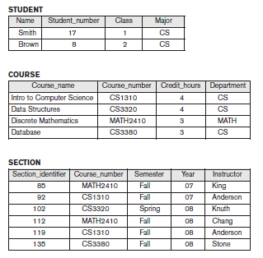
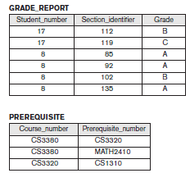
University Database
Courtesy: T1, Elmasri & Navathe

Slide 8
Design an Application
Requirement specification and analysis
Conceptual design
Logical design
Relational DBMS
Physical design

Slide 9
Ques
We can use C++/Java to write a data, read and update the data. Why need a new software and a fresh approach?

Slide 10
Characteristics of Database approach
Self describing data
Abstraction
Program-data independence (Separation of programs and data)
Data model helps in representing what is required
Abstracts implementation details
Multiple views
Sharing and Multiuser transactions

Slide 11
Discussion
What can be queries and update operations?

Slide 12
Discussion
What can be storage structure and search techniques?

Slide 13
Discussion
What are the relationships among records?

Slide 14
Integrity constraints
Restrictions/constraints that must hold for data
E.g. data type, Not Null, (CGPA <=10.0 type)
Referential Integrity:
Section must be related to a course record
Key/Uniqueness:
Course_number must have a unique for all values of course record

Slide 15
Discussion
What are the integrity constraints?

Slide 16
Till now
Database Systems
Designing database applications
Database approach

Slide 17
Outline
Data Models

Slide 18
Data Models
Concepts that help to describe data types, relationships, and constraints.
High level/conceptual
Very close to user
Entity
Attribute
Relationship
e.g. Entity Relationship model
Low level / physical data model
How data is stored and organized in storage media
Access path
Index

Slide 19
Data Models
Representational/ Implementation
Easily understood by end user
Not far from data organization and storage
Relational data model (network, hierarchical data models)
Object data model
Higher level implementation model closer to conceptual data model
Self-describing data models
Schema of data and data combined

Slide 20
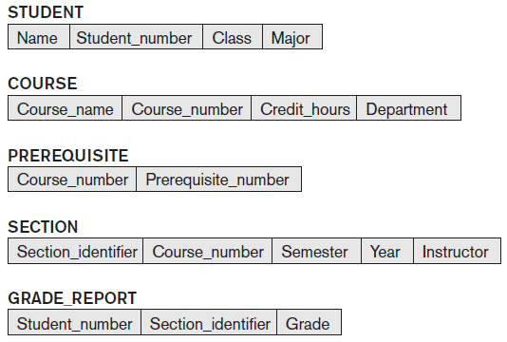
Schema
Description of data: Names of records, data types, constraints

Slide 21
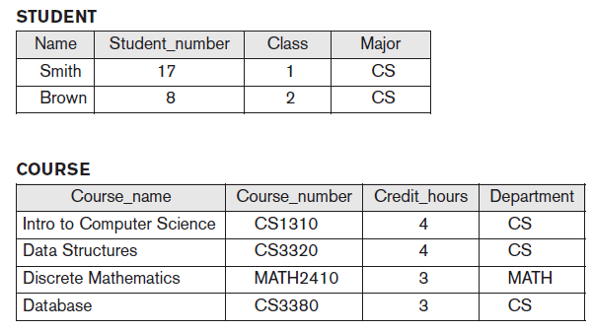
Instance
State satisfying structure and constraints of schema is valid state

Slide 22
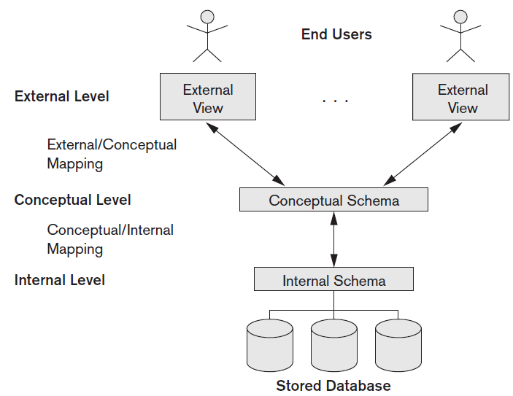
Three-schema architecture

Slide 23
Discussion
What is difference between database schema and database state?

Slide 24
Discussion
What is the need for mapping among schema levels?

Slide 25
Questions?

Slide 26
Why do we need program and data independence?

Slide 27
Why are these four characteristics of database? How do they impact the database positively?

Slide 28
What is the data model and why do we need them in databases/ application?

Slide 29
What is the relation between data model and schema?

Slide 30
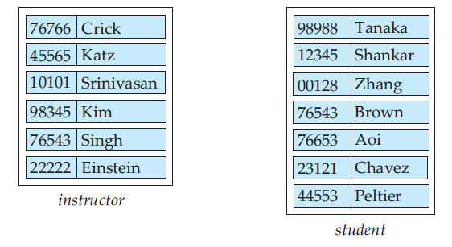
Entities
Entity: any thing or an object. E.g. Amit
Attribute: property that describes entity
Name and Id number
Entity set: e.g. instructor, student

Slide 31
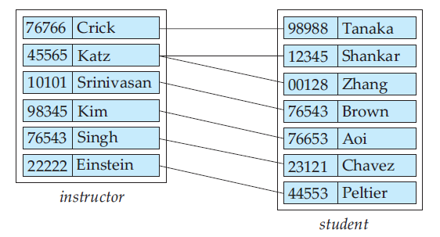
Relationship
Association among several entities.
Advisor relationship between crick and tanaka
Set of relationships of same type
E.g. advisor relationship set (set of all different relationships as advisior)

Slide 32
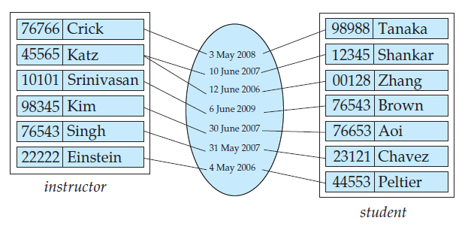
Relationship sets
date as attribute of the advisor relationship set

Slide 33
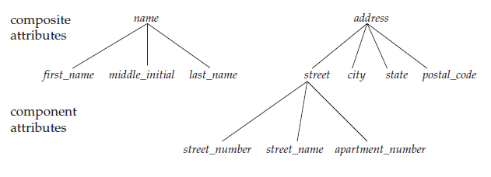
Attributes
Based on subdivision
Simple: No subdivision
E.g. salary
Composite: With subdivision
Name (F Name, M Name, L Name)
Address

Slide 34
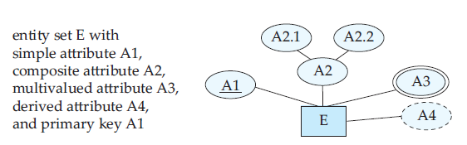
Attributes contd..
Number of values
Single valued
Date of birth
Multivalued
Phone number
Stored:
Date of birth
Derived
Age

Slide 35
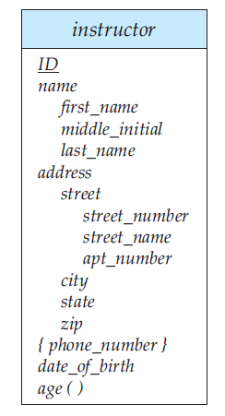
Complex attributes
Complex: multivalued and composite
More than one address with
each address having more than one phone

Slide 36
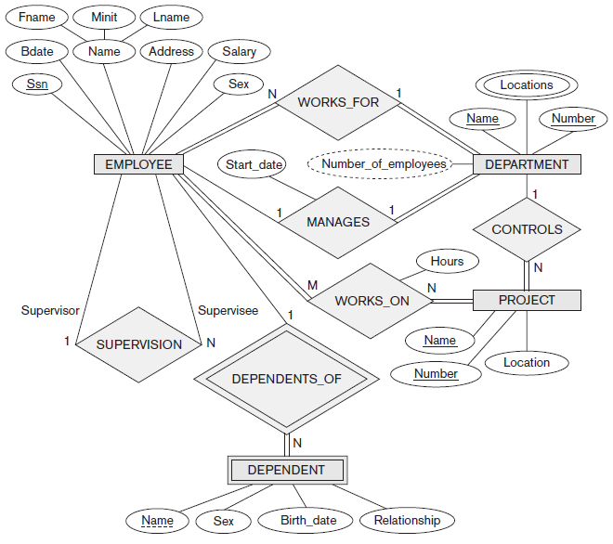

Slide 37
Discussion
What is the type of following attributes for person entity type
Name
Age
Phone number
Address
Date of birth

Slide 38
Discussion
What is the type of following attributes for person entity type
Name: composite, single valued, stored
Age : simple, single valued, derived
Phone number: simple, multi-valued, stored
Address: composite, single valued, stored
Date of birth: simple, single valued, stored

Slide 39
Why Study Databases??
Simply fascinating
Commercially very relevant !!
DBMS encompasses most of CS
OS, languages, theory, AI, multimedia, logic
Significance of Databases with Internet
Datasets increasing in diversity and volume.
Numeric and Textual Databases
Multimedia Databases
Geographic Information Systems (GIS)
Data warehousing, Data mining, Business Intelligence
Digital libraries, interactive video.
... need for DBMS exploding
Database Design and Applications (CSI ZG518/ SSZG518)

Slide 40
Tsunami of Data
Telecom data (≈ 4.6 bn mobile subscribers)
There are 3 Billion Telephone Calls in US each day, 30 Billion emails daily, 1 Billion SMS, IMs.
IP Network Traffic: up to 1 Billion packets per hour per router. Each ISP has many (hundreds) routers!
WWW
Weblog data (160 mn websites)
Email data
Satellite imaging data
Social networking sites data
No. of pics on Facebook
15 bn unique photos
60 bn photos stored (4 sizes)
Database Design and Applications (CSI ZG518/ SSZG518)
Notes:
40

Slide 41
Big Names in Database Systems
Company Product
Oracle Oracle 8i, 9i, 10g,11g, 12c, 18c
IBM DB2, Universal Server
Microsoft Access, SQL Server-2008
Sybase Adaptive Server
Informix Dynamic Server
Database Design and Applications (CSI ZG518/ SSZG518)

